Slide 1


ONLINE PAYMENT FRAUD DETECTION
(a 10Alytics Data Science Project)
GROUP 1 MEMBERS
Theresa Ofili
Nicholas Odoemenam
Adekanmbi Adepeju
Peter Adeyi

Slide 2
EXECUTIVE SUMMARY
Following the rise in fraudulent activities across different platforms, it has become imperative for action to be taken across board to stem every opportunity fraudsters have to perpetuate their act.
Hence, we carried out an Exploratory Data Analysis on online payment fraud detection to detect;
most defrauded customers
average time used to defraud each customer
type of online transactions with the highest fraud
type of online transactions with the most earned by the receiver
most earned receiver and the balance
customer that reported the fraud
From our findings we discovered;
Top Ten defrauded customers from our data set. Customer C1715283297 was the most defrauded customer.
Cash_out and Payment channels are the most attempted channels for fraud.
The Payment channel is positively correlated with a successful fraud.
Customer C439737079 earned the most from a successful fraud.
Although Fraud through Transfers are not commonly attempted, they portend a great disaster in terms of monetary value to unsuspecting customers whenever they are successfully carried out.

Slide 3
DATASET USED
We used an Online Payments Fraud Detection Dataset from Kaggle (https://www.kaggle.com/).
The Dataset has the 11 columns that explicitly explains information collected as described below;
# | Columns | Description
1 | Step | Represents A Unit Of Time Where 1 Step Equals 1 Hour
2 | type | Type Of Online Transaction
3 | amount | The Amount Of The Transaction
4 | nameOrig | Customer Starting The Transaction
5 | oldbalanceOrg | Balance Before The Transaction
6 | newbalanceOrig | Balance After The Transaction
7 | nameDest | Recipient Of The Transaction
8 | oldbalanceDest | Initial Balance Of Recipient Before The Transaction
9 | newbalanceDest | The New Balance Of Recipient After The Transaction
10 | isFraud | Fraud Transaction
11 | isFlaggedFraud | Whether or not Fraud Transaction was flagged.
The Dataset also contains 6,362,620 rows which represents the number of cases from the survey carried out and has no missing data.

Slide 4
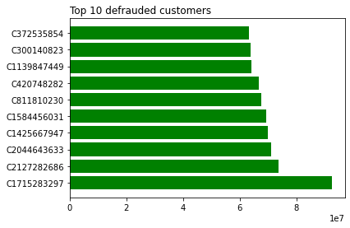
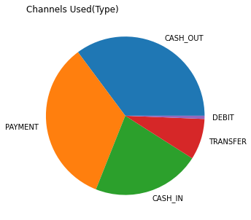
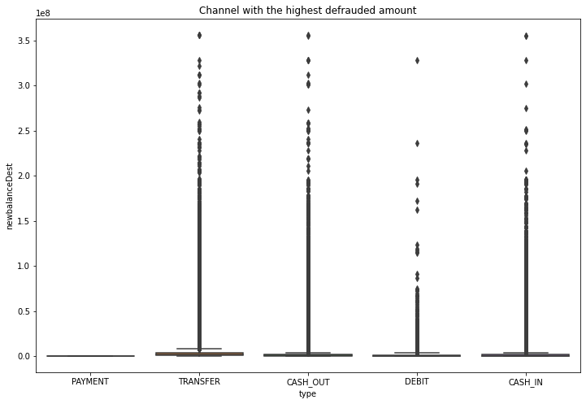
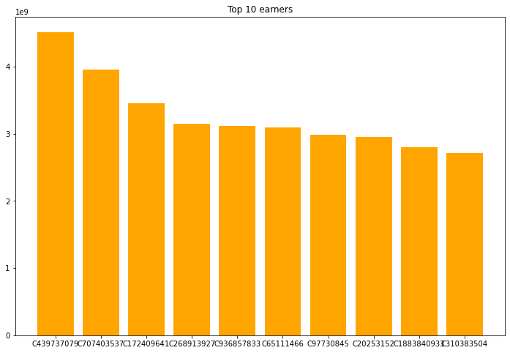
VISUALIZATION
Chart 1.0: Top Ten Defrauded Customers
Chart 2.0: Type of online transaction with the highest fraud
Chart 4.0: Channel with the highest defrauded amount
Chart 3.0: Top Ten Earners from Fraud

Slide 5
CONCLUSION
Customer Sensitization and Awareness: There should be regular sensitization and awareness to customers not to give out sensitive information and where such information has been compromised there should contact their bank.
Security on the channels should be regularly upgraded to the latest technology to stop fraud. There should be a software in place to debug if a suspicious transaction is noticed on the channel.
For customers receiving a particular amount, there should be a hold on the account and confirmation made to determine the authenticity and validity of the transaction.
If a fraud can be detected within a stipulated time, it can be stopped. Hence, Banks should promptly address every fraud report they get from their customers.
Appropriate sanctions should be meted out on every caught fraudster to deter a reoccurrence and discourage others from attempting it.

